Slide 1


Randall Hidalgo Sánchez
2025-07-14
https://github.com/randall-hidalgosanchez/IBM-Capstone

Slide 2

Outline
Executive Summary
Introduction
Methodology
Results
Conclusion
Appendix

Slide 3
Executive Summary
Summary of methodologies
Summary of all results

Slide 4
Introduction
SpaceX advertises Falcon 9 rocket launches on its website, with a cost of 62 million dollars; other providers cost upward of 165 million dollars each, much of the savings is because SpaceX can reuse the first stage. Therefore, if we can determine if the first stage will land, we can determine the cost of a launch. This information can be used if an alternate company wants to bid against SpaceX for a rocket launch.
We will predict if the Falcon 9 first stage will land successfully.

Slide 5

Section 1

Slide 6
Methodology
Executive Summary
Data collection methodology:
Data was obtained from SpaceX API and complemented with Falcon9 launches information scrapped from Wikipedia
Perform data wrangling
Data was processed to obtain a variable “Outcome” with 1 meaning landing was successful and 0 meaning landing was not successful.
Perform exploratory data analysis (EDA) using visualization and SQL
Perform interactive visual analytics using Folium and Plotly Dash
Perform predictive analysis using classification models
Four models were tested: Logistic regression, SVM, Decision Trees and KNN.
Cross-validations was implemented to obtain the best parameters

Slide 7
Data Collection
Describe how data sets were collected.
You need to present your data collection process use key phrases and flowcharts

Slide 8
Data Collection – SpaceX API
Present your data collection with SpaceX REST calls using key phrases and flowcharts
https://github.com/randall-hidalgosanchez/IBM-Capstone/blob/main/Scripts/01.%20jupyter-labs-spacex-data-collection-api.ipynb
Place your flowchart of SpaceX API calls here

Slide 9
Data Collection - Scraping
Present your web scraping process using key phrases and flowcharts
https://github.com/randall-hidalgosanchez/IBM-Capstone/blob/main/Scripts/02.%20jupyter-labs-webscraping.ipynb
Place your flowchart of web scraping here

Slide 10
Data Wrangling
Describe how data were processed
You need to present your data wrangling process using key phrases and flowcharts
https://github.com/randall-hidalgosanchez/IBM-Capstone/blob/main/Scripts/03.%20labs-jupyter-spacex-Data%20wrangling.ipynb

Slide 11
EDA with Data Visualization
Summarize what charts were plotted and why you used those charts
https://github.com/randall-hidalgosanchez/IBM-Capstone/blob/main/Scripts/05.%20pandas-matplotlib-edadataviz.ipynb

Slide 12
EDA with SQL
Using bullet point format, summarize the SQL queries you performed
https://github.com/randall-hidalgosanchez/IBM-Capstone/blob/main/Scripts/04.%20jupyter-labs-eda-sql-coursera_sqllite.ipynb

Slide 13
Build an Interactive Map with Folium
Summarize what map objects such as markers, circles, lines, etc. you created and added to a folium map
Explain why you added those objects
https://github.com/randall-hidalgosanchez/IBM-Capstone/blob/main/Scripts/06.%20lab_jupyter_launch_site_location_interactive.ipynb

Slide 14
Build a Dashboard with Plotly Dash
Summarize what plots/graphs and interactions you have added to a dashboard
Explain why you added those plots and interactions
https://github.com/randall-hidalgosanchez/IBM-Capstone/blob/main/Scripts/07.%20spacex-dash-app.py

Slide 15
Predictive Analysis (Classification)
Summarize how you built, evaluated, improved, and found the best performing classification model
You need present your model development process using key phrases and flowchart
https://github.com/randall-hidalgosanchez/IBM-Capstone/blob/main/Scripts/08.%20SpaceX_Machine%20Learning%20Prediction_Part_5.ipynb

Slide 16
Results
Exploratory data analysis results
Interactive analytics demo in screenshots
Predictive analysis results

Slide 17

Section 2

Slide 18
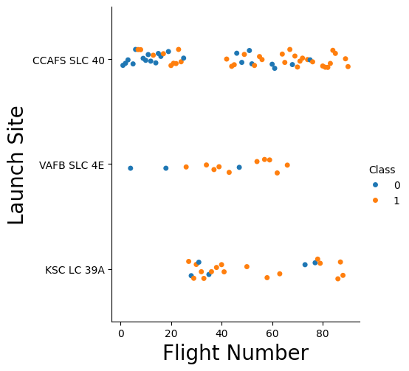
Flight Number vs. Launch Site
Show a scatter plot of Flight Number vs. Launch Site
Show the screenshot of the scatter plot with explanations

Slide 19
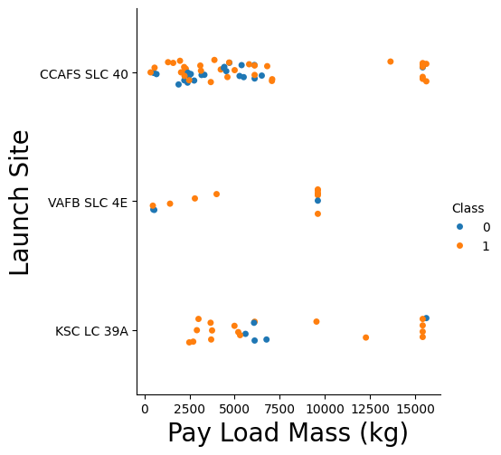
Payload vs. Launch Site
Show a scatter plot of Payload vs. Launch Site
Show the screenshot of the scatter plot with explanations

Slide 20
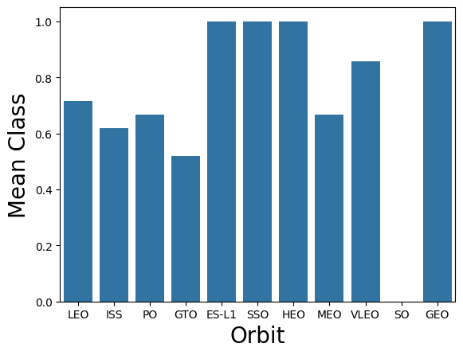
Success Rate vs. Orbit Type
Show a bar chart for the success rate of each orbit type
Show the screenshot of the scatter plot with explanations

Slide 21
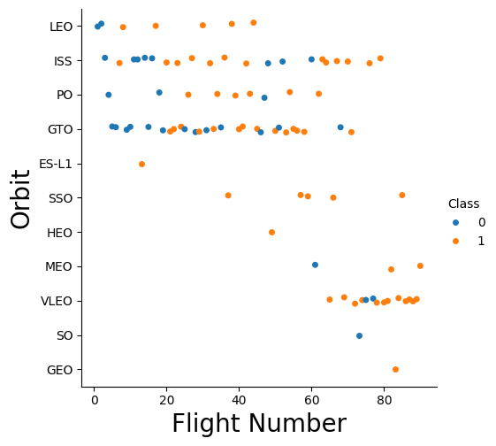
Flight Number vs. Orbit Type
Show a scatter point of Flight number vs. Orbit type
Show the screenshot of the scatter plot with explanations

Slide 22
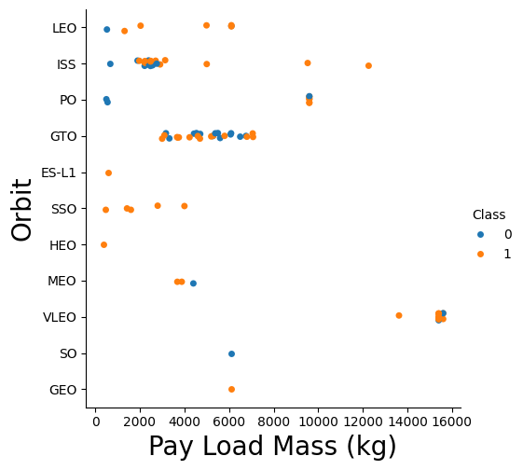
Payload vs. Orbit Type
Show a scatter point of payload vs. orbit type
Show the screenshot of the scatter plot with explanations

Slide 23
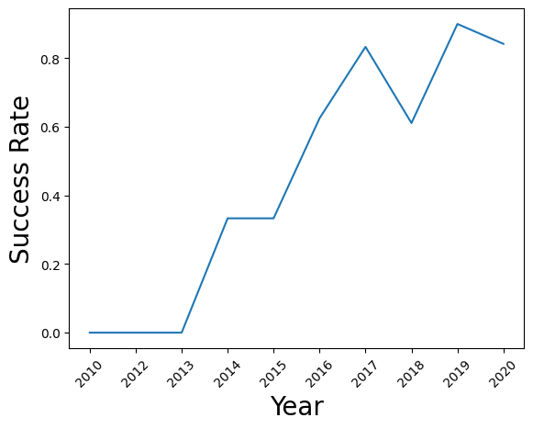
Launch Success Yearly Trend
Show a line chart of yearly average success rate
Show the screenshot of the scatter plot with explanations

Slide 24
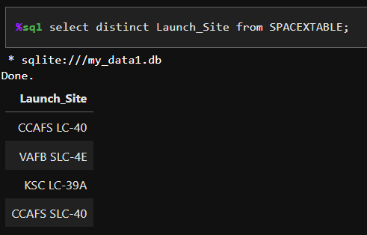
All Launch Site Names
The following quary takes the variable Launch_Site from the table SPACEXTABLE and shows the unique values.

Slide 25
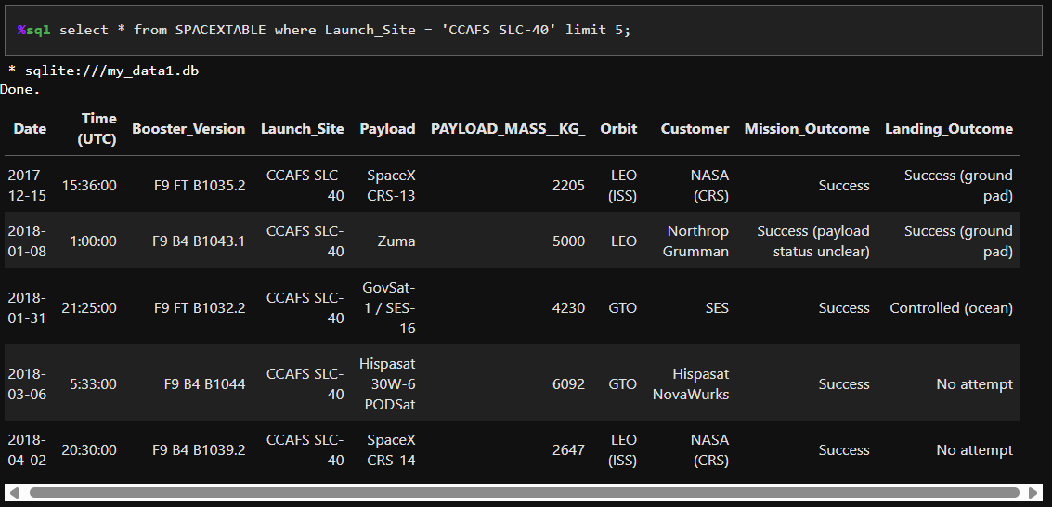
Launch Site Names Begin with 'CCA'
This code takes the variable Launch_Site from the table SPACEXTABLE and extracts 5 rows where Launch_Site is “CCAFS SLC-40”.

Slide 26
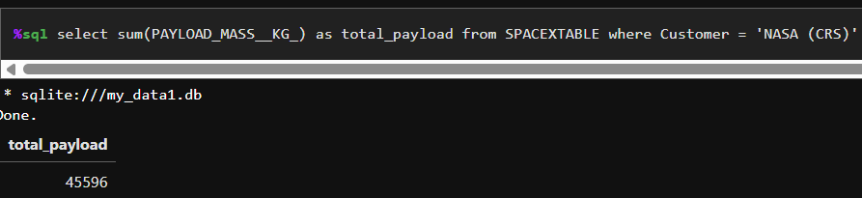
Total Payload Mass
The following query calculates the sum of PAYLOAD_MASS_KG for all rows from SPACEXTABLE table where Customer is “NASA (CRS)”

Slide 27
Average Payload Mass by F9 v1.1
Calculate the average payload mass carried by booster version F9 v1.1
Present your query result with a short explanation here

Slide 28
First Successful Ground Landing Date
Find the dates of the first successful landing outcome on ground pad
Present your query result with a short explanation here

Slide 29
Successful Drone Ship Landing with Payload between 4000 and 6000
List the names of boosters which have successfully landed on drone ship and had payload mass greater than 4000 but less than 6000
Present your query result with a short explanation here

Slide 30
Total Number of Successful and Failure Mission Outcomes
Calculate the total number of successful and failure mission outcomes
Present your query result with a short explanation here

Slide 31
Boosters Carried Maximum Payload
List the names of the booster which have carried the maximum payload mass
Present your query result with a short explanation here

Slide 32
2015 Launch Records
List the failed landing_outcomes in drone ship, their booster versions, and launch site names for in year 2015
Present your query result with a short explanation here

Slide 33
Rank Landing Outcomes Between 2010-06-04 and 2017-03-20
Rank the count of landing outcomes (such as Failure (drone ship) or Success (ground pad)) between the date 2010-06-04 and 2017-03-20, in descending order
Present your query result with a short explanation here

Slide 34

Section 3

Slide 35
<Folium Map Screenshot 1>
Replace <Folium map screenshot 1> title with an appropriate title
Explore the generated folium map and make a proper screenshot to include all launch sites’ location markers on a global map
Explain the important elements and findings on the screenshot

Slide 36
<Folium Map Screenshot 2>
Replace <Folium map screenshot 2> title with an appropriate title
Explore the folium map and make a proper screenshot to show the color-labeled launch outcomes on the map
Explain the important elements and findings on the screenshot

Slide 37
<Folium Map Screenshot 3>
Replace <Folium map screenshot 3> title with an appropriate title
Explore the generated folium map and show the screenshot of a selected launch site to its proximities such as railway, highway, coastline, with distance calculated and displayed
Explain the important elements and findings on the screenshot

Slide 38

Section 4

Slide 39
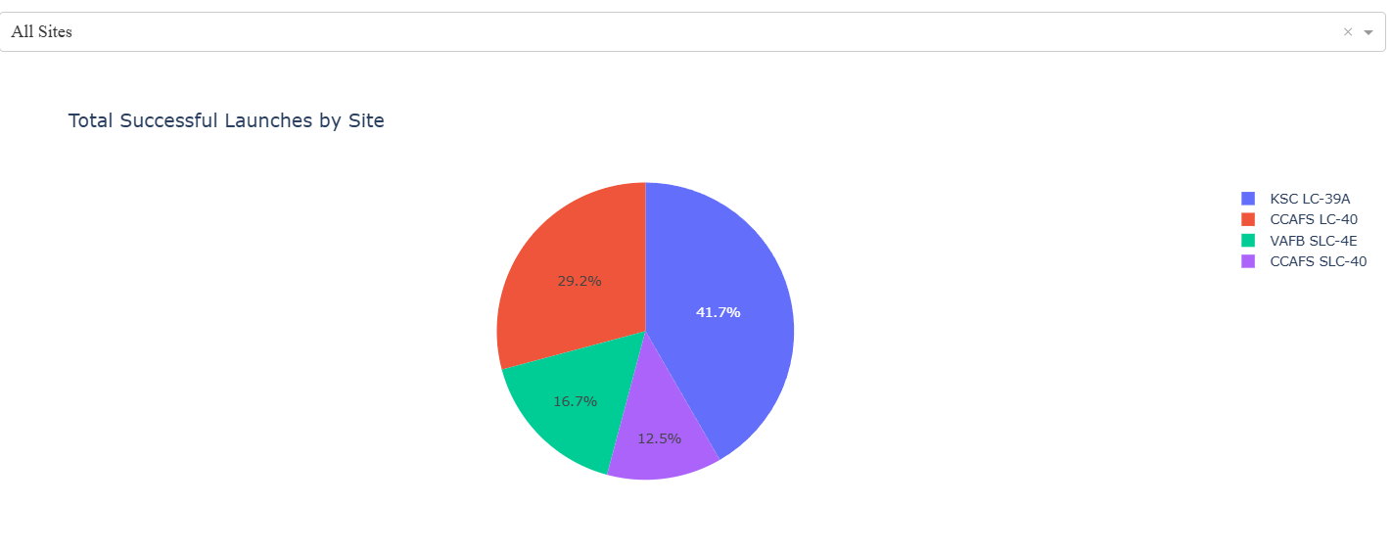
Successful Launches
In the following plot we can observe the percentage of succesfull launches by launching site. The location with the highest success is KSC LC-39A

Slide 40
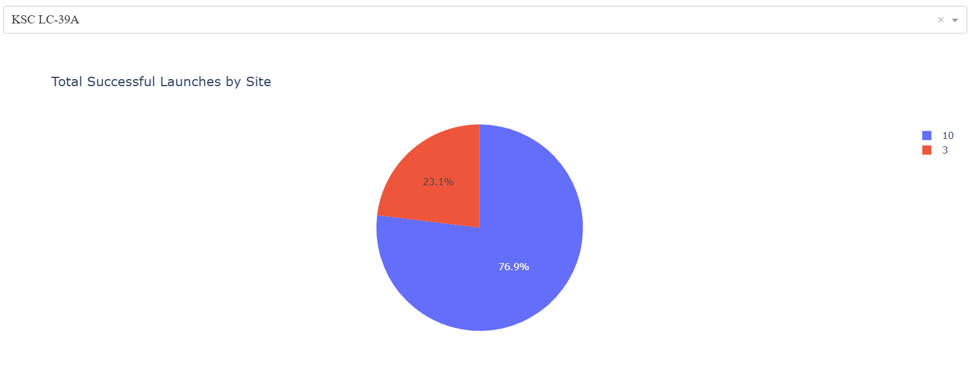
Successful Launches on KSC LC-39A
Following the previous plot, here we observe the proportion of successful launches on KSC LC-39A. 76.9 % of the launches were successful.

Slide 41
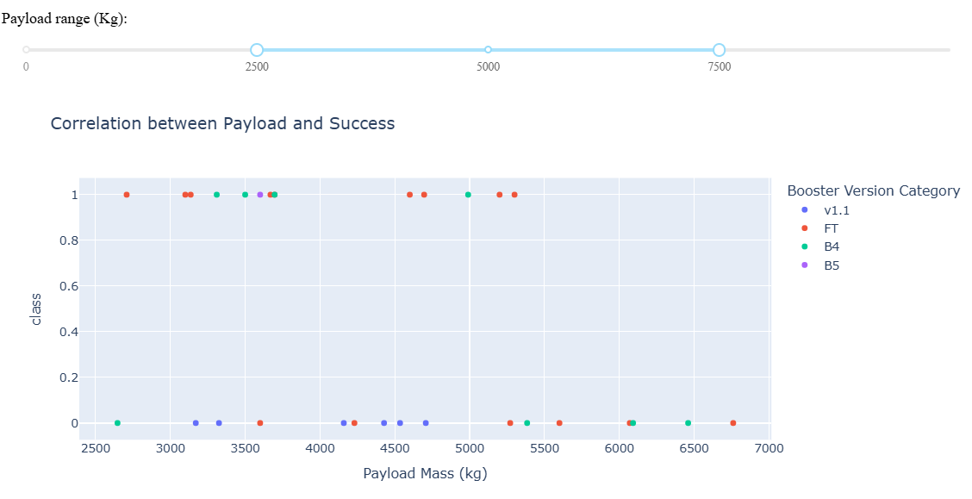
Payload vs Success
Here we observe the correlation between Payload and Success, using the payload range between 2500-7500 (Kg).

Slide 42

Section 5

Slide 43
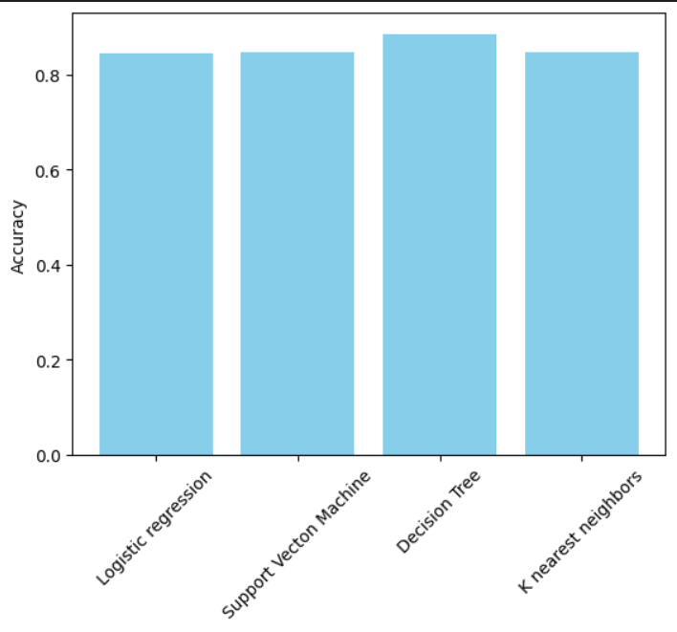
Classification Accuracy
The plot compares the accuracy of all models. For this comparison the model used is the one with the best parameters. Based on this plot, the decision tree model has the higher accuracy.

Slide 44

Confusion Matrix
The confusion matrix shows that the model predicted correctly 15 of the 18 samples in the test data.
Only 3 samples that did not landed were predicted wrongly (as landed)

Slide 45
Conclusions
Point 1
Point 2
Point 3
Point 4
…

Slide 46
Appendix
Include any relevant assets like Python code snippets, SQL queries, charts, Notebook outputs, or data sets that you may have created during this project

Slide 47


